Slide 1
Cisco FINAL Presentation
Normal company with 150 user and 200 pc
VÕ Minh Trí

Slide 2
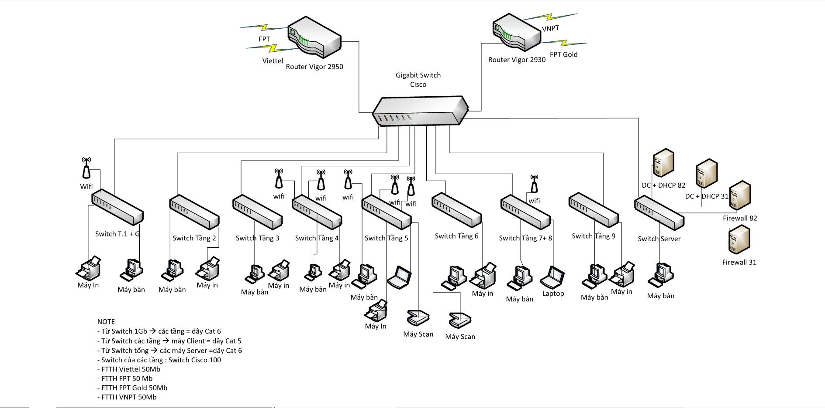
network diagram

Slide 3
material
Vigor3200 Router
MERAKI CISCO MX400
Cisco Catalyst 3560
Cisco Small Business 100
CISCO MERAKI WIRELESS LAN - MR32

Slide 4
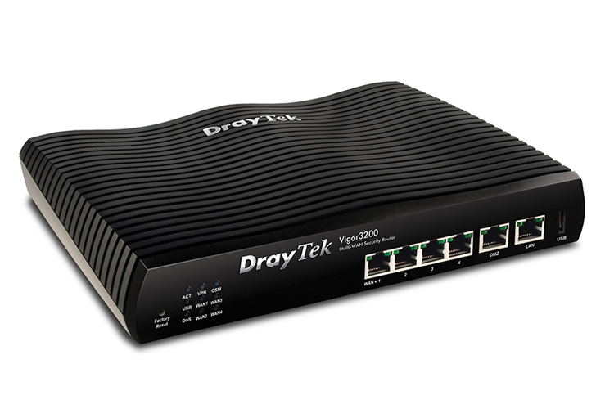
Vigor3200 Router
Vigor 3200 Load Balancer Unified Security Firewall
- 4 Gigabit WAN: Outbound Policy-Based Load-Balance, BoD (Bandwidth on Demand), WAN Connection Fail-over
- 1 DMZ port
- 1 Gigabit LAN port with 4 VLAN and 7 Subnet.
- USB port for 3G modem and FTP/Printer server
- VPN sever with 64VPN tunnels, 30 SSL VPN tunnels, Easy for Branch-to-office, Teleworker-to-Office
- Real-time email/Syslog alert when virus/attack is detected
- Enterprise level Content Security Management (CSM)
- GlobalView Web Content Filter powered by CommTouch
- Dynamic DNS; multi-NAT; DHCP Server, DNS cache & proxy.
- Bandwidth Management: Class-based Bandwidth Guarantee by User-Defined Traffic categories, Bandwidth / Session Limitation, Routing/DHCP/ARP table.
- Bind IP to MAC, Internet Access Control/Retriction, Limit Access
- Firewall Facilities: SPI, CSM, Bind IP (DHCP) to MAC Address, IP Address Anti-Spoofig, DoS/DDoS Prevention, Policy-Based IP Packet Filter
- Firewall with SPI based IP filters, Dos/DDoS prevention, and Object-based policy for easy settings
- Secure remote management, SNMP Agent with MIB-II

Slide 5
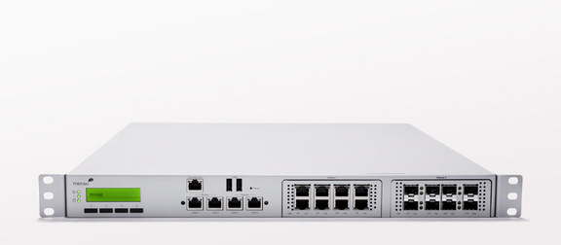
MERAKI CISCO MX400 fire wall
HardwareSFP / SFP+ for 1G / 10G connectivity Swappable interface modules Stateful firewall throughput: 1 Gbps Redundant power supplies Supports approximately up to concurrent 2,000 users Cloud-based centralized managementManaged centrally over the Web Classifies applications, users and devices Zero-touch, self-provisioning deployments Networking and securityStateful firewall Auto VPN™ self-configuring site-to-site VPN Active Directory integration Identity-based policies Client VPN (IPsec) Smart link bonding | Traffic shaping and application managementLayer 7 application visibility and traffic shaping Application prioritization Web caching Choose WAN uplink based on traffic type WAN optimizationReduces intra-site bandwidth consumption Accelerates CIFS, FTP, HTTP, and TCP traffic WAN optimization cache: 1 TB Advanced security servicesContent filtering Google SafeSearch and YouTube for Schools Intrusion prevention (IPS) Antivirus and antiphishing filtering Requires Advanced Security License

Slide 6
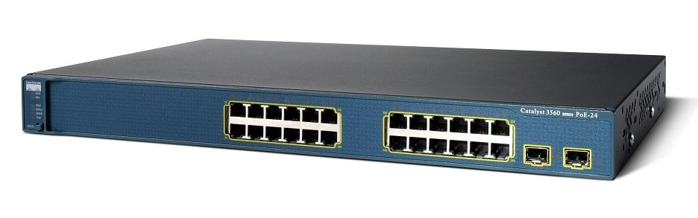
Cisco Catalyst 3560
Simple, Seamless & Secure Smart Office Solutions That's how easy to put Cisco pieces together into your business. Get it now Data Sheets and Literature Compare Models Improve Service and Security in Your LAN View Compact Switch Interactive Model The Cisco Catalyst 3560 v2 Series are next-generation, energy-efficient, Layer 3 Fast Ethernet switches. These new switches support Cisco EnergyWise technology, which helps companies manage power consumption of the network infrastructure and network-attached devices, thereby reducing their energy costs and their carbon footprint. The new switches consume less power than their predecessors and are ideal access layer switches for enterprise, retail, and branch-office environments. They help you maximize productivity and provide investment protection by enabling a unified network for data, voice, and video. Software The Cisco Catalyst 3560 is available with one of two software images: IP Base software includes advanced quality of service (QoS), rate limiting, access control lists (ACLs), Open Shortest Path First (OSPF) for routed access, and IPv6 functionality. IP Services software provides a broader set of enterprise-class features, including advanced hardware-based IP Unicast and IP Multicast routing, as well as policy-based routing (PBR). Simple Network Management Available for the Catalyst 3560 Series, the Cisco Network Assistant is a centralized management application for switches, routers, and wireless access points. Free of charge, the application provides configuration wizards that greatly simplify the implementation of converged networks and intelligent network services.

Slide 7
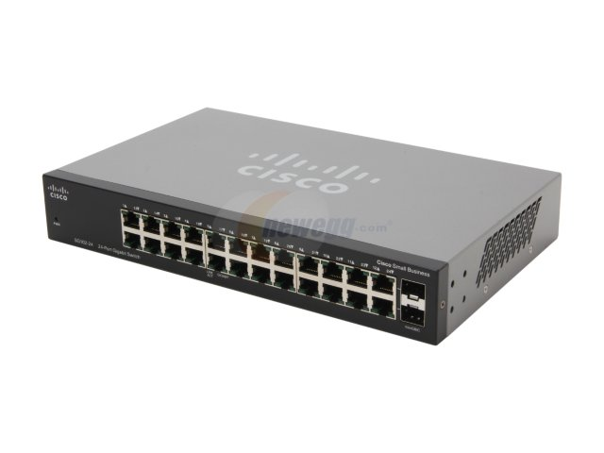
Cisco Small Business 100
Cisco 100 Series Unmanaged Switches offer:
High-performance capabilities: Get powerful network performance at an affordable price and give your office a boost of speed and capacity to support bandwidth-intensive applications
An eco-friendly solution: A variety of power-saving features, including Energy-Efficient Ethernet, optimizes power usage and reduces energy consumption without compromising performance
Peace of mind: All Cisco 100 Series Unmanaged Switches are protected for the life of the product by the Cisco Limited Lifetime Hardware Warranty
Ease of use: Ready to use right out of the box, there is no software to install and nothing to configure

Slide 8
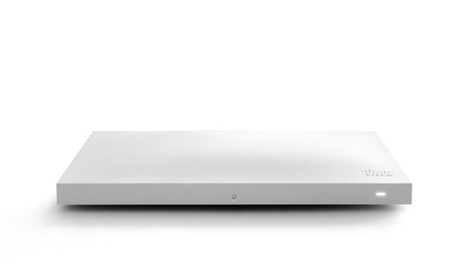
CISCO MERAKI WIRELESS LAN - MR32
deal use cases Performance-critical wireless LANs High-density environments Hardware features 3 radios: 2.4 and 5 GHz, dual-band WIDS/WIPS 2-stream 802.11ac and 802.11n, up to 1.2 Gbps Integrated Bluetooth low energy radio Gigabit Ethernet port PoE: Full functionality with 802.3af AC adapter available Cloud management Network-wide visibility and control Self-provisioning for rapid deployment Automatic reporting Seamless firmware updates Enterprise security 802.1X and native Active Directory integration Air Marshal: real-time WIPS with forensics Stateful Layer 3-7 firewall Identity-based group policies Built-in antivirus scan (NAC) Guest access 1-click secure guest access Guest isolation firewall Customizable splash pages Integrated Facebook login | RF optimizationDual-concurrent, 3-stream MIMO radios Radios optimized for rate-vs-range performance Third radio dedicated to security and RF management Built-in real-time RF spectrum view Cloud-based automatic RF optimization Layer 7 traffic shapingClassifies hundreds of applications Create per-application bandwidth limits Prioritize productivity apps Restrict or block recreational traffic CMX location analyticsMeasure visitor capture rate, visit length, and repeat visit rate Measure visitor trends over time and compare performance across locations Enable location services through integrated iBeacon functionality

